Slide 1
Comparing Canadian Cities

Slide 2
Introduction
- What determines how similar Canadian cities are to each other (in terms of what types of businesses they attract)? Is it geographic location or city size?
- Are large cities across Canada more similar to each other? Or are they more similar to smaller cities within the same province?
- For example, is Toronto (largest city in Ontario) more similar to Vancouver (largest city in British Columbia) or to Peterborough (smaller city in Ontario).

Slide 3
Background
- A successful business owner runs his business in a large Canadian city. He wants to expand to a new location in a new city.
- Is his business more likely to succeed in a smaller city closer to the original location?
- Or is it more likely to succeed in another large city, farther away?

Slide 4
Data and Methodology
Dataset and using Foursquare location data:
Foursqaure data will need to be used to determine what types of businesses are located within each examined city.
Business data from three large cities (Toronto, Vancouver, Montreal) as well as three smaller cities within the same province as each larger city (Peterborough, Victoria, Gatineau) will be used.
Exploratory Data:
I looked at population sizes of Canadian cities to find the 3 largest cities in the Country as well as a smaller city in each corresponding province.
I downloaded business data from Foursqaure API to identify most common business categories in each city.
Techniques:
I conducted k-Means analysis to identify similar clusters of cities based on businesses.
I mapped the cities.
I conducted One-Hot Encoding in order to convert categorical variables into a form that can be used by Machine Learning Algorithms.

Slide 5
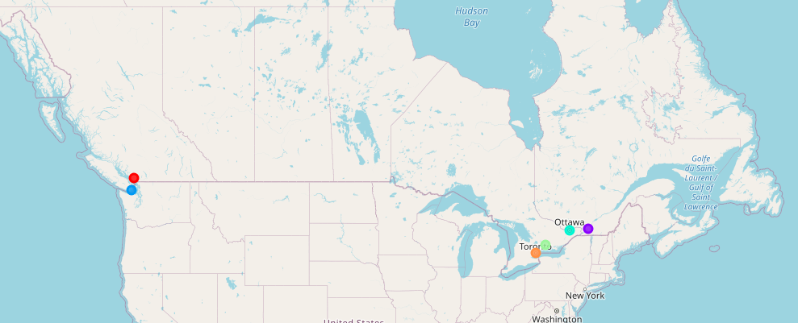
Analysis

Slide 6
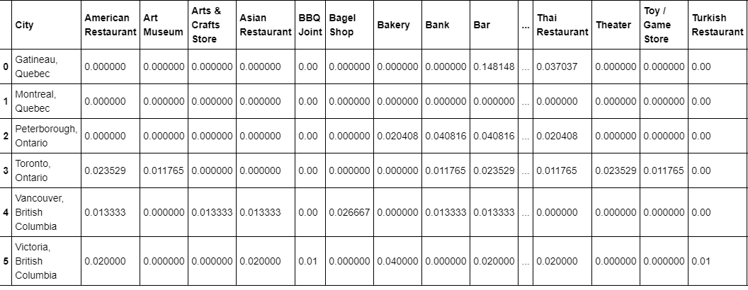
Analysis

Slide 7
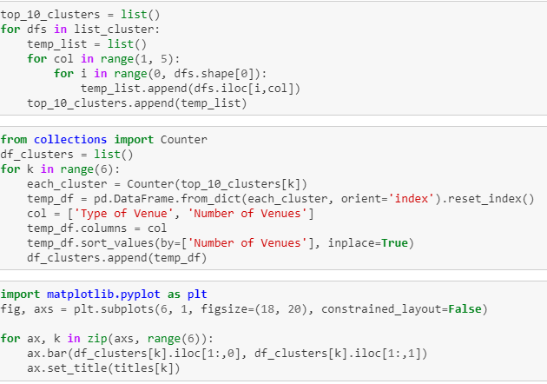
Analysis

Slide 8
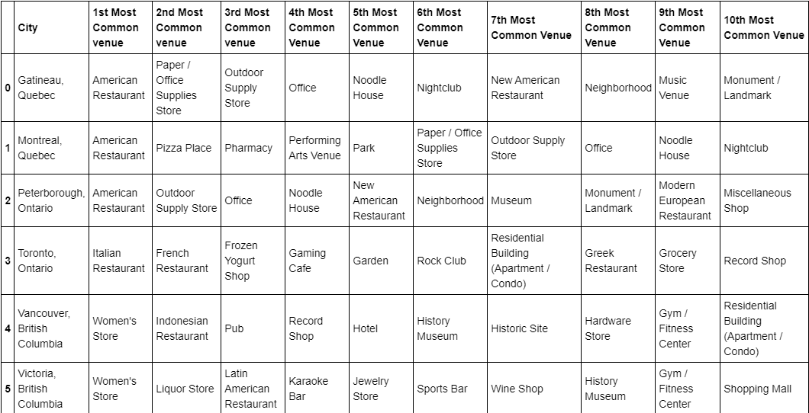
Results

Slide 9
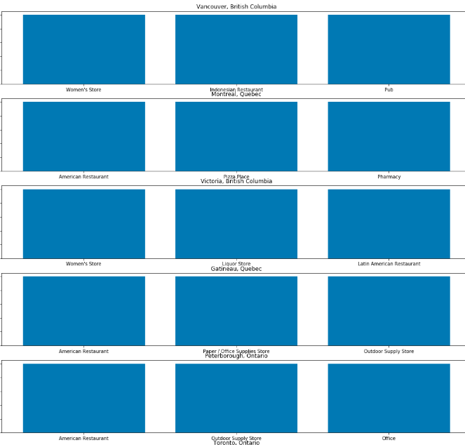
Results

Slide 10
Results
The 3 top venues in each city were:
Vancouver: Women's Store, Indonesian Restaurant, Pub
Victoria: Women's Store, Liquour Store, Latin American Restuarant
Montreal: American Restaurant, Pizza Place, Pharmacy
Gatineau: American Restaurant, Paper/Office Supplies Store, Outdoor Supply Store
Toronto: Italian Restaurant, French Restaurant, Frozen Yogurt Shop
Peterborough: American Restaurant, Outdoor Supply Store, Office

Slide 11
Results
Large Cities:
Vancouver: Women's Store, Indonesian Restaurant, Pub
Victoria: Women's Store, Liquour Store, Latin American Restuarant
Montreal: American Restaurant, Pizza Place, Pharmacy
Small Cities:
Gatineau: American Restaurant, Paper/Office Supplies Store, Outdoor Supply Store
Toronto: Italian Restaurant, French Restaurant, Frozen Yogurt Shop
Peterborough: American Restaurant, Outdoor Supply Store, Office

Slide 12
Conclusion
Although there are no clear trends, it does appear that smaller cities are more likely to have stores as their most common venue, while larger cities are more likely to have restaurants as their most common venue.

